Slide 1


DOCKER CONTAINERISED WITH DATABASE V/S DOCKER VOLUME

Slide 2

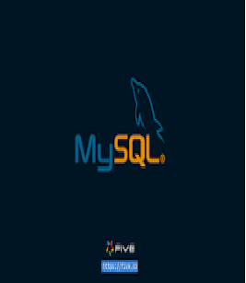
INTRODUCTION:
Docker is an open-source platform that allows you to develop, deploy, and run applications in containers.
Containers are lightweight, portable, and self-sufficient environments that package an application and all its dependencies. This makes it easy to ensure that your application runs consistently across different environments, from development to production.
The process of installing Docker on Ubuntu, and then demonstrate how to create a database inside a Docker container.

Slide 3
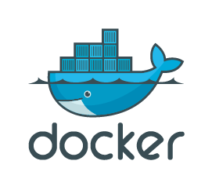
WHAT IS DOCKER?
Docker is an open-source platform that allows developers to automate the deployment, scaling, and management of applications in lightweight, portable containers.
Containers package an application and its dependencies (such as libraries, configurations, and environment variables) into a single unit, ensuring the application runs consistently across different environments (e.g., development, testing, production) without compatibility issues.

Slide 4
KEY CONCEPTS OF DOCKER:
Containers: These are lightweight, standalone, executable packages that include everything needed to run a piece of software (code, runtime, libraries, and system tools). They are isolated from the host system, making them highly portable and reproducible.
Docker Images: These are read-only templates used to create containers. An image contains the application and all its dependencies. Docker images can be pulled from public repositories like Docker Hub or created from a Dockerfile.

Slide 5
KEY CONCEPTS OF DOCKER:
Dockerfile: A script containing a series of instructions on how to build a Docker image. It typically includes things like installing dependencies, setting environment variables, copying files, and specifying the default command to run when the container starts.
Docker Engine: The core component of Docker, responsible for building, running, and managing containers. It consists of the Docker Daemon (which manages containers) and the Docker CLI (command-line interface) for interacting with the daemon.

Slide 6
KEY CONCEPTS OF DOCKER:
Docker Hub: A cloud-based registry service where Docker users can share and access pre-built Docker images. Docker Hub hosts a wide range of public images, such as popular databases, web servers, and development tools.
Volumes: A way to persist data outside of containers. Since containers are ephemeral, volumes are used to store data that needs to survive container restarts or removals.
Docker Compose: A tool for defining and running multi-container Docker applications. It allows you to specify the services, networks, and volumes needed for an application in a single YAML file, simplifying complex setups.

Slide 7
BENEFITS OF DOCKER:
Portability: Docker containers can run on any system that supports Docker, regardless of the underlying operating system.
Consistency: By packaging everything an application needs into a container, Docker ensures that the app will run consistently across different environments.
Isolation: Docker containers provide process and filesystem isolation, which makes it easier to run multiple applications on the same host without conflicts.
Efficiency: Containers are lightweight and use fewer resources compared to traditional virtual machines, leading to faster startup times and less overhead.

Slide 8
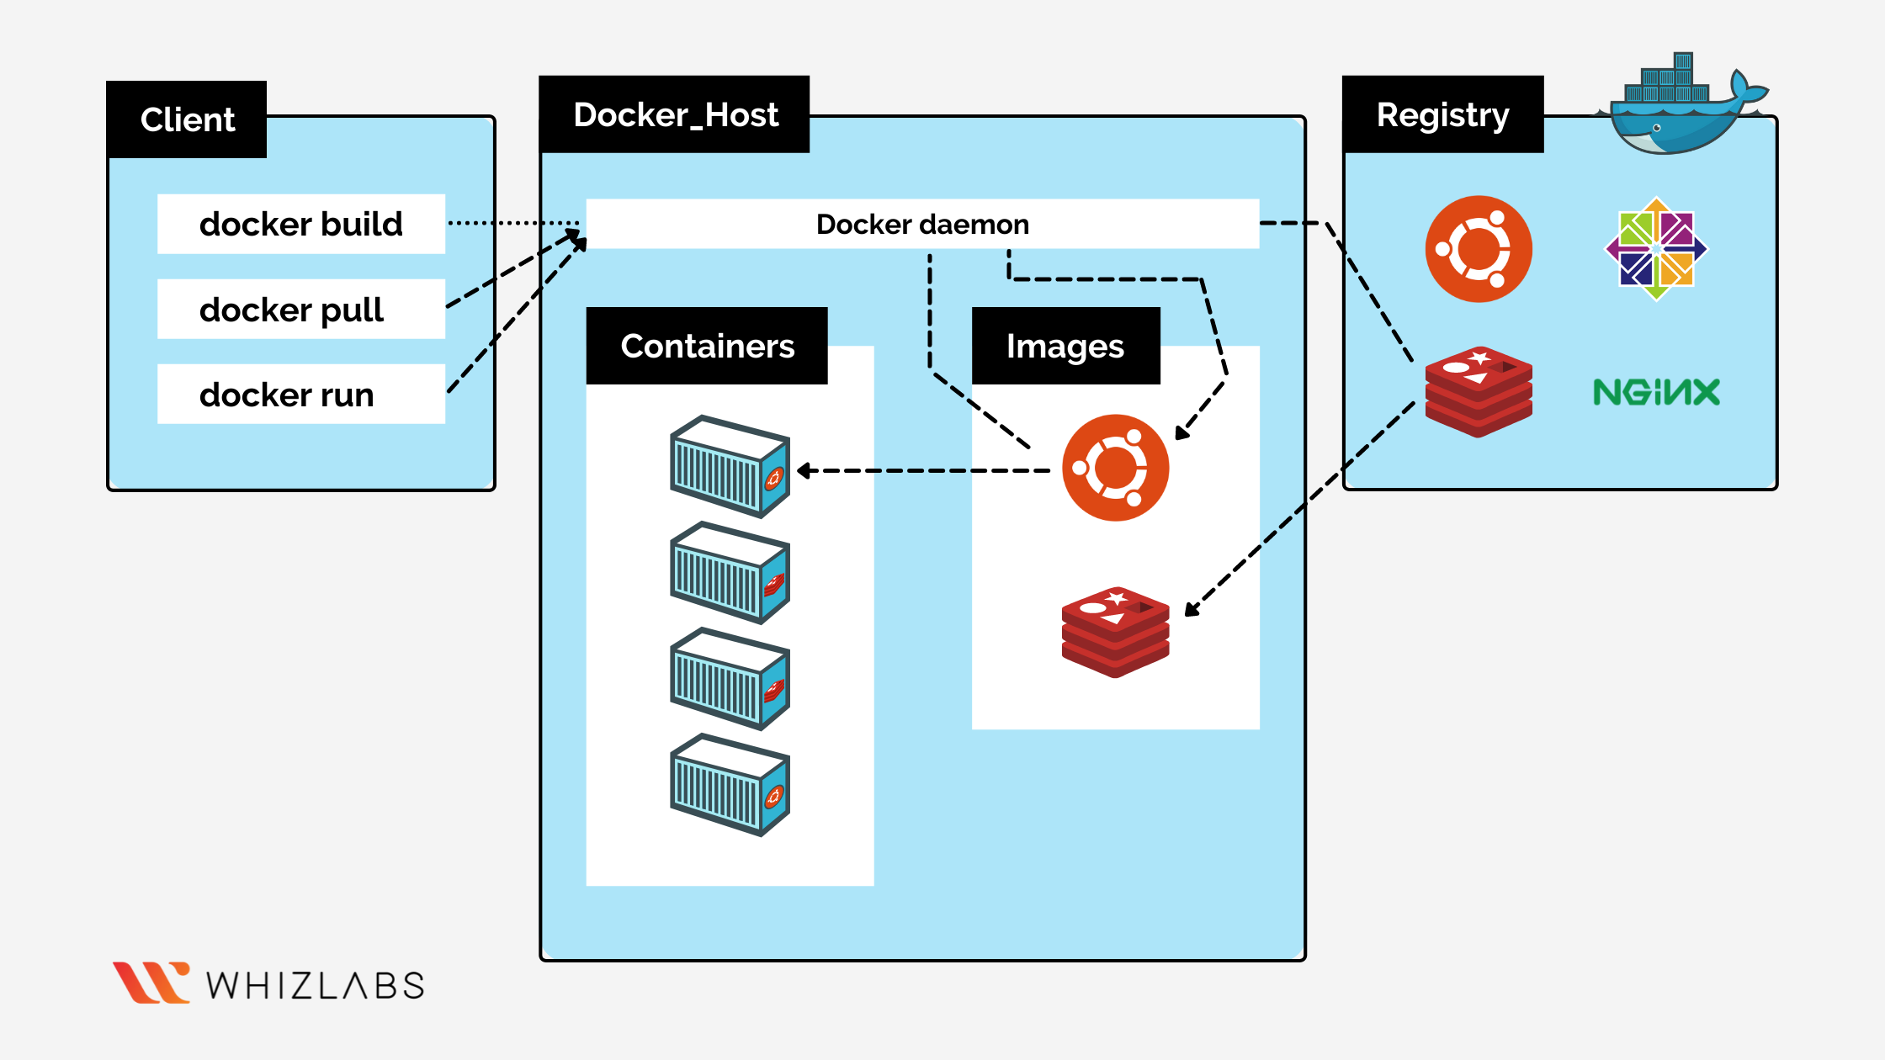
DOCKER ARCHITECTURE:

Slide 9
WHAT IS DOCKER CLIENT?
The Docker client is a command-line interface (CLI) tool used to interact with Docker services and manage Docker containers, images, networks, and volumes. It's the primary way users interact with the Docker platform.
docker build: Create a new Docker image from a Dockerfile.
docker run: Create and start a container from an image.
docker pull: Download an image from a registry.

Slide 10
WHAT IS DOCKER HOST?
A Docker host is the machine where Docker is installed and where Docker containers run.
It includes the Docker daemon, which manages containers and images, and provides an environment for creating and running applications in containers.
Docker hosts can be local or remote, and they can be part of a cluster for scaling and orchestration.

Slide 11
WHAT IS DOCKER REGISTRY?
A Docker Registry is a service that stores and manages Docker images.
It acts as a central repository where Docker images can be stored, shared, and retrieved.
Docker registries allow users to upload (push) images they have built, as well as download (pull) images from a central location.
A Docker Registry is a centralized place to store Docker images that can be pulled, pushed, and managed.

Slide 12
WHAT IS DOCKER HUB?
Docker Hub is a cloud-based registry service provided by Docker that allows users to store, share, and manage Docker images. It is the default registry that Docker clients pull images from when no other registry is specified.
Docker Hub is the default registry where Docker images are stored and shared.
You can pull, push, and manage Docker images using Docker Hub.
Public repositories are free, while private repositories require a paid account.
Docker Hub allows for versioning of images, automated builds, and easy sharing with other Docker users.

Slide 13
DOCKER FILE COMPONENTS:
A Dockerfile is a text file that contains a set of instructions for building a Docker image.
It defines how to assemble the Docker image, including the base image, dependencies, configuration, and the application itself.
Each instruction in a Dockerfile creates a new layer in the image, which is cached for faster builds in subsequent executions.

Slide 14
EXAMPLE OF A COMPLETE DOCKER FILE:
# Use the official MySQL image as the base
FROM mysql:5.7
# Set environment variables for MySQL (you can replace them with your own settings)
ENV MYSQL_ROOT_PASSWORD=rootpassword
ENV MYSQL_DATABASE=mydatabase
ENV MYSQL_USER=myuser
ENV MYSQL_PASSWORD=mypassword
# Optionally, copy initialization scripts into the container to set up the database schema
COPY ./init.sql /docker-entrypoint-initdb.d/
# Expose the default MySQL port
EXPOSE 3306

Slide 15
WHAT IS DATABASE?
A database is an organized collection of data that is stored and managed electronically, typically in a digital format.
The data is structured in a way that allows for easy access, management, modification, and retrieval.
Databases are used to store all types of information, from simple text records to complex datasets, and are critical for many applications, ranging from websites to enterprise software and scientific research.

Slide 16
WHAT IS MYSQL?
MySQL is an open-source relational database management system (RDBMS) that uses Structured Query Language (SQL) to manage and interact with databases.
It is one of the most popular RDBMSs due to its reliability, speed, and ease of use.
MySQL is used to store, manage, and retrieve data for web applications, enterprise software, and other systems that require persistent data storage.

Slide 17
STEPS :CREATE AN INSTANCE
1.Click on the EC2 service in AWS Management Console 2.Click on the launch instance. 3.In launching the instance firstly click on the Name and tags(anyname).

Slide 18
4.Application and OS Images(Amazon machine image) choose ubuntu. 5.Instance type(t2.micro)

Slide 19
6.key pair (login)
create key pair or select the existing key pair name.
The below images shows that the key pair login --create key pair--select the existing key pair.

Slide 20
7.network settings(vpc,subnet and auto-assign public IP). 8.Inbound security group rules Select --ssh--http--https--all tcp--all traffic--anywhere.

Slide 21
9.configure storage and after click on the launch instance. The below images shows the ec2 instance is running successfully.

Slide 22
10.The instance is running and connect with .pem file or ec2 instance connect.

Slide 23
Here click on the ec2 instance connect , and connect using ec2 instance connect and see the below image like.

Slide 24
STEPS ARE INVOLVING TO CREATE DOCKER CONTAINER WITH DATABASE:
sudo apt update
sudo apt install apt-transport-https ca-certificates curl software-properties-common
curl -fsSL https://download.docker.com/linux/ubuntu/gpg | sudo gpg --dearmor -o /usr/share/keyrings/docker-archive-keyring.gpg
echo "deb [arch=amd64 signed-by=/usr/share/keyrings/docker-archive-keyring.gpg] https://download.docker.com/linux/ubuntu $(lsb_release -cs) stable" | sudo tee /etc/apt/sources.list.d/docker.list > /dev/null
sudo apt update
sudo apt install docker-ce
sudo docker --version
sudo systemctl enable docker
sudo systemctl start docker

Slide 25
sudo systemctl status docker here the below image shows that the docker is active running..

Slide 26
sudo usermod -aG docker $USER
newgrp docker
docker run hello-world
docker --version

Slide 27
sudo systemctl status docker
docker run hello-world
docker info
docker ps

Slide 28
docker pull mysql:latest
Here the below image shows that the we are pull the mysql:latest image from docker hub.

Slide 29
docker run --name mysql-container -e MYSQL_ROOT_PASSWORD=my-secret-pw -d mysql:latest

Slide 30
docker ps
docker exec -it mysql-container mysql -u root -p
enter password:my-secret-pw
welcome to the MYSQL monitor .The below shows that the MYSQL monitor is ready to use.

Slide 31
STEPS:
1.Database Commands
Create a Database
CREATE DATABASE database_name;
Use a Database
USE database_name;
Show All Databases
SHOW DATABASES;
Drop (Delete) a Database
DROP DATABASE database_name;
2. Table Commands
Create a Table
CREATE TABLE table_name (
column1 datatype,
column2 datatype,
...
);
Show Tables
SHOW TABLES;
Describe Table Structure
DESCRIBE table_name;
Drop (Delete) a Table
DROP TABLE table_name;
Alter Table (Add Column)
ALTER TABLE table_name ADD column_name datatype;
Alter Table (Modify Column)
ALTER TABLE table_name MODIFY column_name new_datatype;

Slide 32
3. Data Manipulation Commands
Insert Data
INSERT INTO table_name (column1, column2, ...)
VALUES (value1, value2, ...);
Select Data (Retrieve)
SELECT column1, column2, ... FROM table_name;
Select All Data
SELECT * FROM table_name;
Select Data with Condition (WHERE)
SELECT * FROM table_name WHERE condition;
Update Data
UPDATE table_name SET column1 = value1, column2 = value2 WHERE condition;
Delete Data
DELETE FROM table_name WHERE condition;
4. Index Commands
Create an Index
CREATE INDEX index_name ON table_name (column_name);
Drop an Index
DROP INDEX index_name ON table_name;

Slide 33
CREATE DATABASE:
create database demo;
use demo
create table student(name varchar(30),id int not null primary key);
insert into student(name,id) values ('sreevani',1);
desc student;

Slide 34
select * from student;
insert into student(name,id) values ('rekha',2);
desc student;

Slide 35
select * from student;
insert into student(name,id) values ('gayathri',3);
desc student;

Slide 36
select * from student;
show databases;

Slide 37
alter table student add marks int;
update student set marks=100 where id=1;
desc student;

Slide 38
select *from student;
update student set marks=90 where id=2;
select *from student;

Slide 39
select sum(marks) from student;
select avg(marks) from student;
select *from student where name like 'r%';

Slide 40
show databases;
exit
docker stop mysql-container
docker rm mysql-container

Slide 41
docker run --name mysql-container -e MYSQL_ROOT_PASSWORD=root_password -v mysql_data:/var/lib/mysql -d mysql:latest
docker exec -it mysql-container mysql -u root -p
use demo;

Slide 42
show databases;
exit
docker stop mysql-container
docker rm mysql-container
docker ps -a
docker container ls -a
sudo systemctl restart docker
docker run --name mysql-container -e MYSQL_ROOT_PASSWORD=root_password -v mysql_data:/var/lib/mysql -d mysql:latest

Slide 43
docker volume create mysql_data
docker volume ls
docker volume inspect mysql_data
docker exec -it mysql-container mysql -u root -p
Enter password:root_password

Slide 44
create database demo;
use demo;
create table student(name varchar(30),id int not null primary key);
insert into student(name,id) values ('sreevani',1);
desc student;

Slide 45
select * from student;
insert into student(name,id) values ('rekha',2);
desc student;

Slide 46
select * from student;
show databases;
exit
docker stop mysql-container
docker rm mysql-container

Slide 47
docker run --name mysql-container -e MYSQL_ROOT_PASSWORD=root_password -v mysql_data:/var/lib/mysql -d mysql:latest
docker exec -it mysql-container mysql -u root -p
use demo;

Slide 48
SHOW DATABASES;

Slide 49
CONTAINER VS VOLUME:

Slide 50
CONCLUSION:
Containers manage the execution of applications and services.
Volumes handle data persistence, ensuring that important data remains available even when containers are restarted or removed.

Slide 51


